Slide 1
EXPOSYS DATA LABS
Name: Dhiraj Kumar Shastri
Web Development Task:
Create a Multi-Page Responsive Website.
Student Feedback System
GETFIT
FITNESS GYM RESPONSIVE WEBSITE

Slide 2
Abstract
Nowadays online service is the best competitive edge for any organization which makes it different from other organizations.
The Online Fitness Gym is such a system that provides the best platform for ease of access to the Gym Staff.
Customer can check his updates online anytime about fitness or diet plan etc.
The focus of this project is about online services for a fitness club but by minimizing all those defects which are found in the currently available manually file system.
This is the best platform for customers and gym members to interact freely with each other.

Slide 3
Introduction
Fitness and health have become one of the major aspects of concern nowadays.
With new ideas and evolution in the sector of living healthy, and exercising, there is now the unlimited possibility of what we can do.
And the best part about being in this digitalized era is that you have access to almost everything online.
That’s right, now there is no need to wait for health tips, gym memberships, reserve and book personal trainers, or even shop for gym equipment the old-fashioned way.
A simple effective and appealing Fitness and Gym website that allows you easy access to all of these.

Slide 4
Problem Statement
In other countries there are a large number of fitness clubs.
Some of them have only static websites and work manually and do not have such a system as I am going to propose.
Existing System is not providing proper video facilities and diet plans to the member. Time-consuming system. No proper system to make announcements. The message update is not there. Inefficient and slow search.

Slide 5
Proposed System
Proposed System consists of a user-friendly website efficient and proper availability of data which is provided.
Here, the Website is divided into four main parts which are Home, About, Plans, and Trainers.
Along with this other useful options like contact us and blogs are also made available at navigation.
Customer can view detailed information/features list through about the gym.
Fitness class options with training page, Social media icons, Timeline, Pricing Table, Map on the Contact page, testimonial section, and the Form are the key sections on the page.

Slide 6
Components of GETFIT website
Home Page
Main Landing Page.
About Page
It consists of the details about the Getfit gym.
Plans Page
Consists of the pricing plans provided by the gym.
Trainers Page
Trainer Details and their social media handles.
Blog Page
Daily posts for reading and getting information about fitness.
Contact us Page
Here you could try and reach us for any help.

Slide 7
Advantages
To remove the manual or paperwork in the Fitness club.
Provide a platform with an interactive user interface for both customers and admin.
Save the time of both admin and customer.
Get online Plans in an efficient manner.
To save cost for each user.
User friendly.

Slide 8

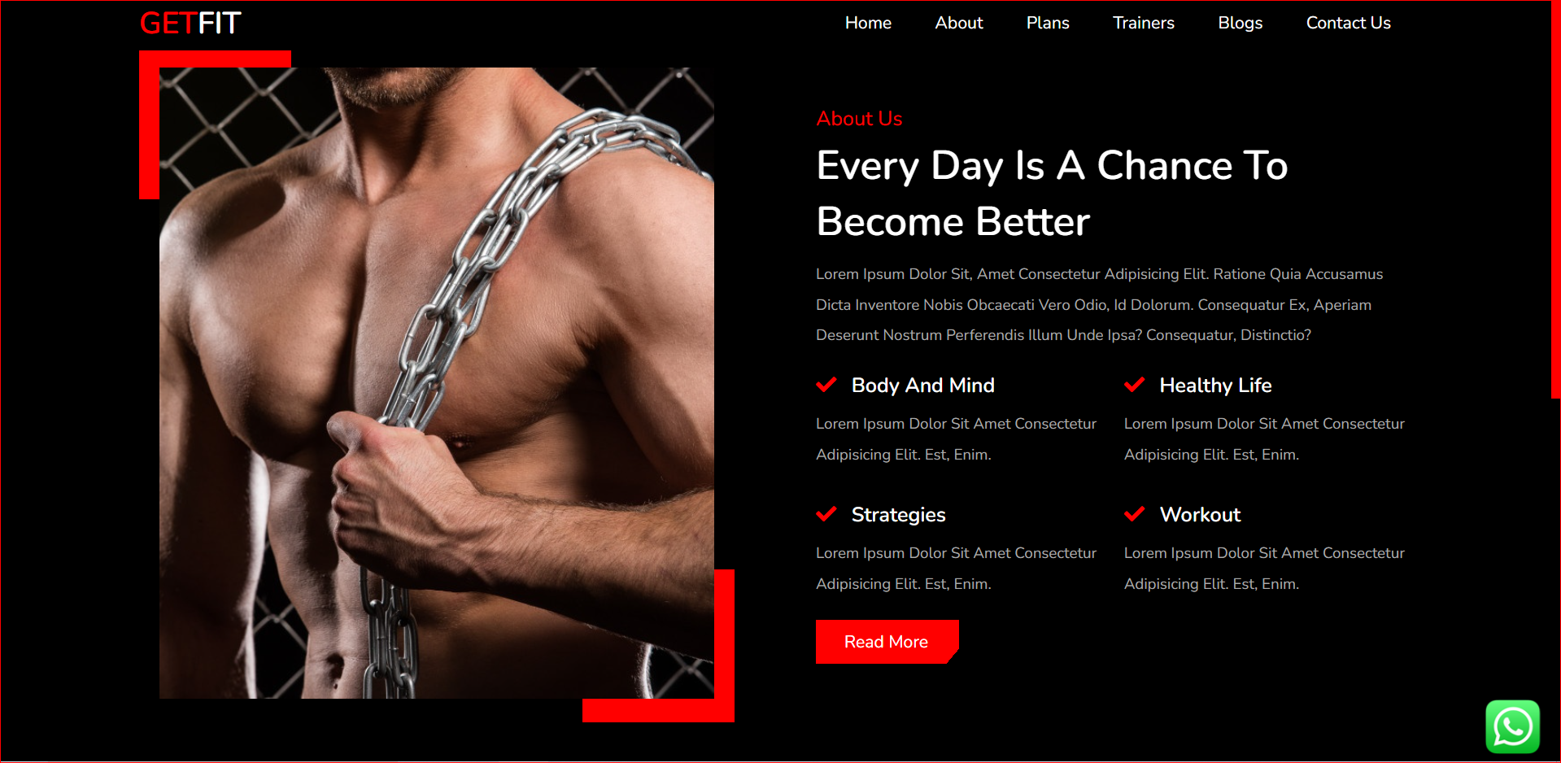
Few screenshots from GETFIT Fitness Website Project:

Slide 9
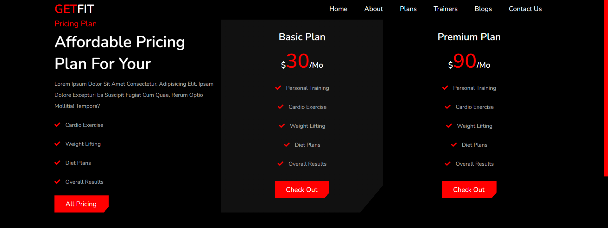
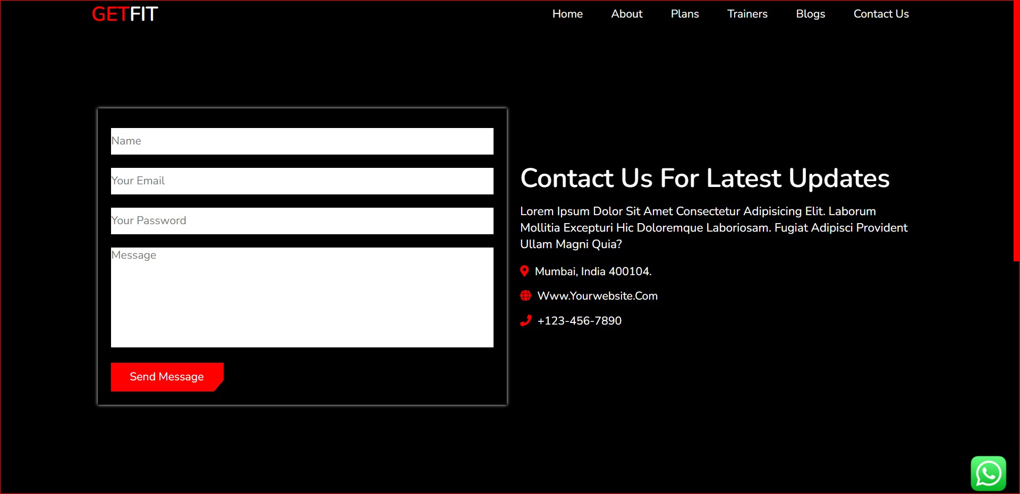

Slide 10

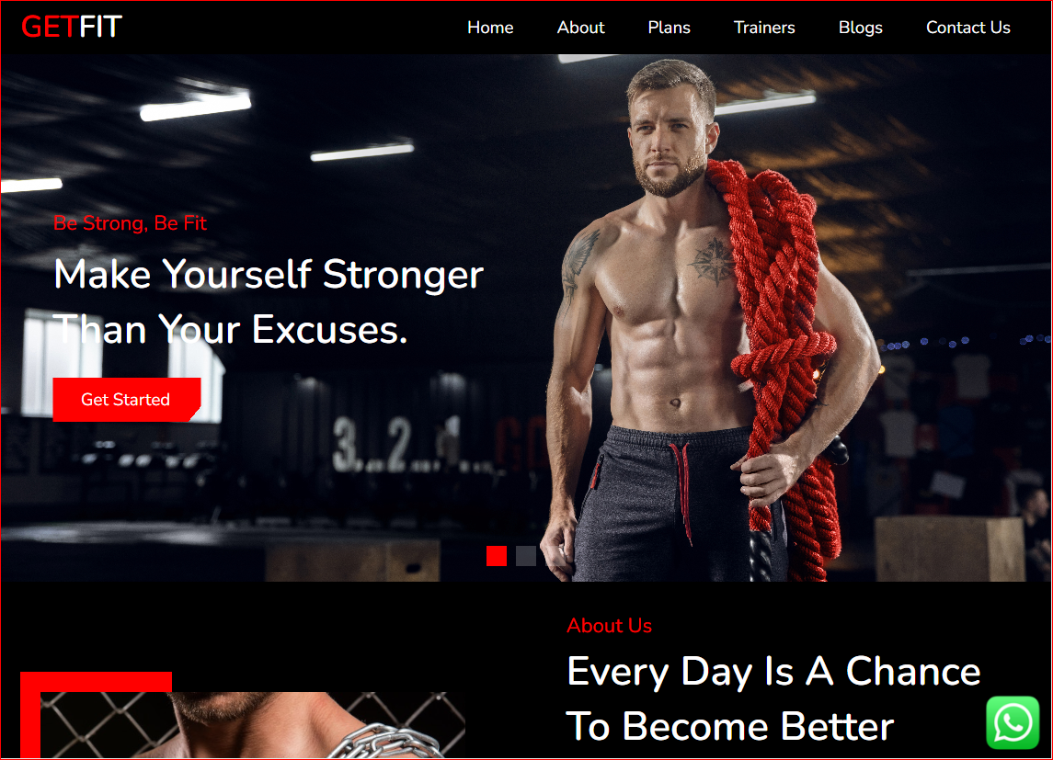
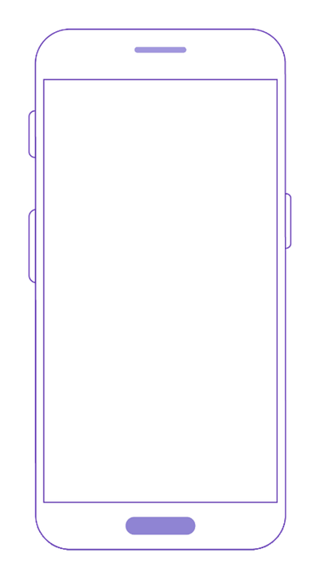
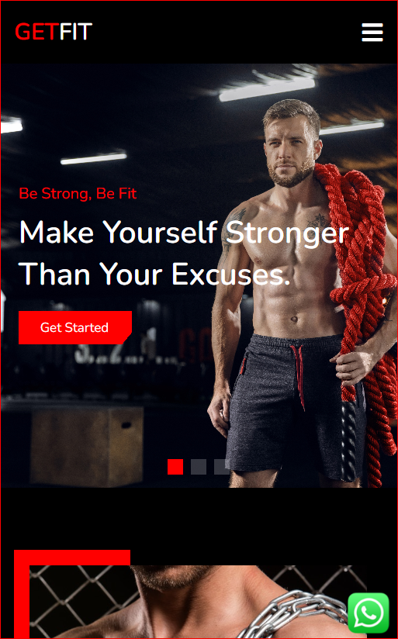

Each page is responsive and uses the size of the design content:
Tablet View
Mobile View
Desktop View

Slide 11
Technology Used
The technologies used are:
HTML (Hypertext markup language)
CSS (Cascading style sheet)
SASS (Syntactically Awesome Stylesheet)
JavaScript
Editor:
Visual Studio Code
Browser:
Google Chrome

Slide 12
Future Scope
Future Scope for the Fitness Website is immense.
The health and fitness industry has become extremely diverse in the range of services and facilities it offers; varying from large-scale leisure centers and gymnasiums to individual personal trainers who travel from one client to the next in their cars.
This project has been developed in such a manner, that new changes(plans and offers) can be constantly applied.
For this reason, it is a must-have for any business in the fitness industry.
Various other options can also be added for the better usability of the project.
This project is the base for later enhancements such as porting this project as a smartphone app connected to the internet since smartphones and high-speed internet have become an integral part of society.

Slide 13
Conclusion
As a conclusion, I can say that this internship was a wonderful experience.
Thanks for giving me this project, I acquired deeper knowledge concerning my technical skills but I was also personally benefitted.
There are huge opportunities available for the students who want to work in this field. Many private and public organizations hire web designer for their online work and website development.
Also an experienced person in this field can also work as a freelancer; there are many online companies which provide online projects to the individuals.

Slide 14
THANK YOU

